Slide 1
Kia ora welcome to our webinar
Thanks for joining us. Your camera and mic are turned off, but once the session starts you can ask the team questions
Questions emailed in should be answered during webinar
Questions asked during webinar will be answered if time allows or in writing
Questions can be asked after the webinar – engagement@ccc.govt.nz
Web browsers (using Teams app)
Web browsers (no app)
Mobile users
Email engagement@ccc.govt.nz
Use Teams chat
Use Teams Q&A

Slide 2
PC14 Housing and Business Choice Plan Change update
And introduction to the Crown-led investigation
14 December 2022

Slide 3
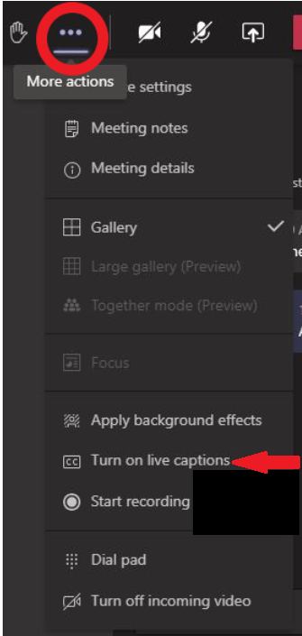
Your camera and mic are turned off, but you can ask the team questions
Questions emailed in should be answered during webinar
Questions asked during webinar will be answered if time allows or in writing
Questions can be asked after the webinar – engagement@ccc.govt.nz
Web browsers (using Teams app)
Web browsers (no app)
Mobile users
Email engagement@ccc.govt.nz
Use Q&A or Teams chat
Use Teams Q&A

Slide 4
Introductions and webinar format
Mark Stevenson
Ike Kleynbos
Format for the session
Thanks for your questions – these will be answered in the presentation
Mics and videos are off to keep the session flowing
We’ll pause for questions at the end of the presentation
Mop-up questions will be answered in writing
Your presenters

Slide 5
Purpose
Reminder of Council’s obligations
Overview of what we’ve done since September
Summary of what the alternative proposal looks like
Answer questions
Later:
John Hardie, appointed Investigator, presents and answers questions, as required

Slide 6
Work completed this year
May/April – Release of PC13, 14, and 15 draft
June – Release of summary of feedback
September – Final draft proposal released
Oct/Nov – Alternative proposal begins
Notes:
We have talked about the various plan changes in passing. This table lays out the different jigsaw pieces and where each one fits in.
Note that a more detailed A3 Table is to be circulated to EMs on the different plan changes, and the different components of them (inform approach v influence approach).
Note that the Christchurch Transport Plan and Flood Management Areas work is progressing in parallel, but decisions to consult on and/or notify these pieces of work will be sought later. (7 April for the CTP, and post notification for the FMA)
This work is also being carried out in the context of the development of the Greater Christchurch Spatial Plan (GCSP), and the Otautahi Christchurch Plan (OCP)

Slide 7
Central government steps – Intensification
2020: National Policy Statement – Urban Development (NPS-UD) requires District Plan changes to enable intensification
2021: Parliament amends the Resource Management Act (RMA) to
sets Medium Density Residential Standards (MDRS)
May 2022: Minister requires Council decisions by August 2023, following hearings by Independent Hearings Panel

Slide 8
What the legislation means
Up to 12m housing (about three storeys) across most of the city, and up to three houses per section, without requiring a consent – known as MDRS (Medium Density Residential standards).
MDRS must apply to all ‘relevant’ residential zones within the ‘urban environment’ – both set in the Act.
We have to allow more housing to be built, especially around commercial centres, under Policy 3 of NPS-UD (National Policy Statement for Urban Development).
Situations when developments require neighbours approval and rules for subdivisions needs to change – we have to allow more development.
We can identify Qualifying Matters in areas that are unsuitable for increased housing – they aren’t a way to stop all intensification.

Slide 9
Policy 3 of the NPS-UD
Strongest requirement for intensification
Directs for central city to “maximise development capacity” within the centre
Most Councils have interpreted this as no height limit
We have proposed 90m limit (consent from 22m) before onerous consenting requirements apply
Directs for “at least 6 storey development in at least a walkable catchment” from edge of city centre
Must increase this based on centre prominence and surrounding accessibility and demand
800m is seen as minimum
Directs for commensurate intensification around suburban commercial centre

Slide 10
Summary of residential scope - MDRS
Current residential zones within scope:
Current residential zones outside of scope:
Residential suburban zone Residential new neighbourhood zone Residential Banks Peninsula zone (any within urban environment) Residential hill zone | Residential suburban density transition zone Residential medium density zone Residential city centre zone
Residential large lot zone Residential small settlement zone Residential guest accommodation zone | Residential Banks Peninsula zone (any outside urban environment) Papakāinga/Kāinga Nohoanga Zone

Slide 11
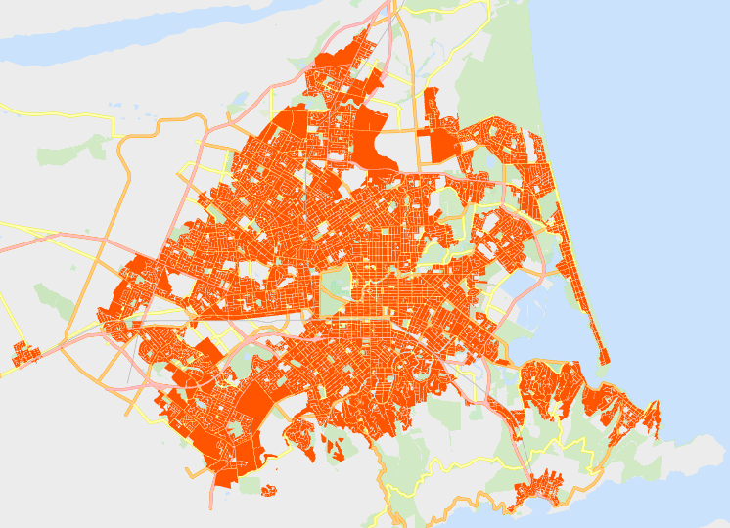
Summary of overall scope
Areas within scope:
All urban residential zones, incl. associated Qualifying Matters
Commercial centres & surrounds
Other associated controls (subdivision, fencing, engineering, access, etc)
Areas outside of scope:
Anything outside of urban environment
New greenfield areas, incl. rural zones
Non-residential activities

Slide 12
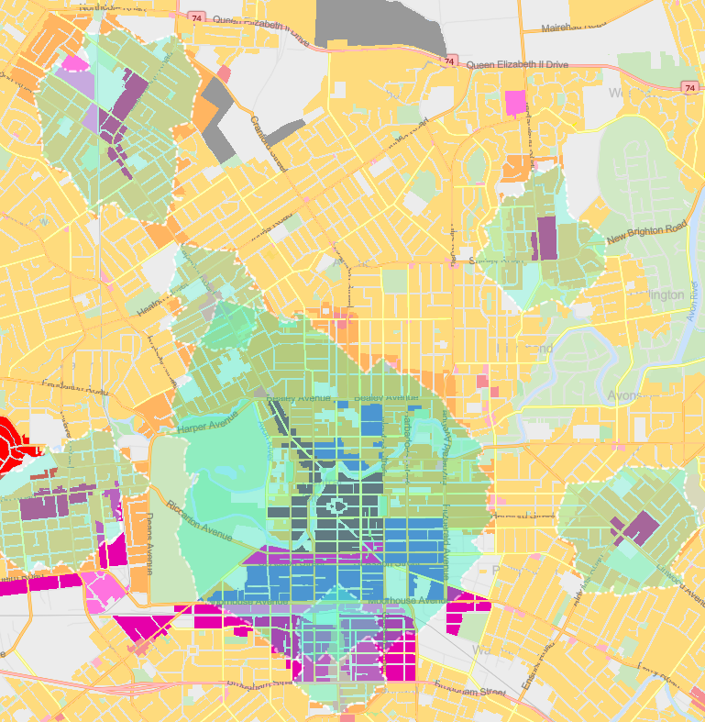
What we can influence
Qualifying Matters
Intensification may be reduced where a Qualifying Matter applies
We are not able to negate all intensification
A high threshold for inclusion of a Qualifying Matter, with strong evidence required.
Extent of the walkable catchment from the city centre and suburban centres
The height limits that are deemed to be ‘commensurate with the level of commercial activity and community services’
Evidence base required to justify modifying any of the above

Slide 13
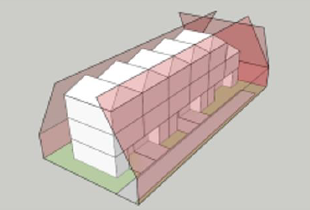
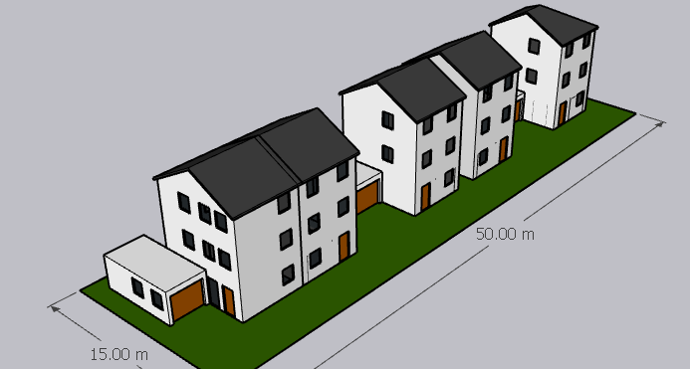
Plan Change 14 Implements the MDRS
MDRS in all residential zones, for buildings up to 12m:
Recession Planes at 4m + 60 degrees
Min 1.5m setback (street) and 1m (otherwise)
Max 50% building coverage
Min 20m² outdoor living space
Min 20% glazing on the street facing façade
Min 20% landscaping
Possible MDRS development form
(assumes 2 parent sites)

Slide 14
High Density Proposal
Directed by Policy 3 – minimum heights and commensurate response
Builds on hierarchy of centres
Enabled building heights must respond to the degree of facilities and services provided within centres
Consent required for any development >14m in height, or >3 units, with specific urban design considerations
Centre Type | Location | Extent | Enabled Height
Neighbourhood Centre & ‘Small’ Local Centres | Addington; Fendalton; Edgeware; Parklands; Woolston; St Martins, etc. | Centre only | MDRS – 12m
‘Medium’ Local Centre | Bishopdale; Barrington; Prestons; Belfast* | 200m | 14m – four storeys
‘Large’ Local Centre | Merivale; Sydenham; Church Corner | 400m | 20m – six storeys
Town Centre | Linwood; North Halswell; Shirley | 400m | 20m – six storeys
‘Large’ Town Centre | Riccarton; Hornby; Papanui | 600m | 20m – six storeys

Slide 15
Currently proposed Qualifying Matters
Infrastructure:
Airport noise contour
Electricity Transmission Corridors and Infrastructure
Radio Communication Pathway
Railway Building Setback
Vacuum sewer constraints areas
Lyttelton Port influence area
Natural environment & features:
Outstanding Nature Features and Landscapes
Significant and other tree setbacks
Sites of Ecological Significance
Styx River Setback (Belfast/Northwood Commercial Centre area)
Waterbody setbacks
Natural hazards:
Coastal inundation hazard areas
Coastal erosion hazard
Flood Ponding Management Areas
High Flood Hazard Management Area
High slope instability hazards
Built form:
Victoria street commercial building height restriction
Lyttelton commercial building height restriction
Residential Character Areas
Heritage & Culture:
Arts Centre building heights
Cathedral Square
Central City heritage interface
Heritage items and settings
Heritage areas and interfaces
New Regent Street building heights
Riccarton Bush Interface Area
Sites of Cultural Significance (Wāhi Tapu / Wāhi Taonga; Belfast Silent File; Ngā Tūranga Tūpuna; Ngā Wai)

Slide 16
Potential new or updated Qualifying Matters (QMs)
Qualifying matter | Detail
Key transport corridors | Restrict development along front boundary of Riccarton and Papanui corridors
Public open space | Due to Policy 3, protect open spaces and parks from high density intensification
Residential-industrial interface | Respond to boundary effects along interface
Greenfield development features | Due to Policy 3, applying high density zoning & including development plan features as QM
Property access to high natural hazard risk areas | Restricting intensification to sites unable to be accessed due to natural hazards
Riccarton bush interface – extension | Increases the current approach of about 40 sites to about 250 sites
Heritage items and areas | Adding in select sites; removing about 100 sites from Lyttelton Heritage Area

Slide 17
Additional changes to anticipate
Residential Provisions
Future Urban Zone rationalisation
Specific Purpose Zone: Schools & Hospitals
Commercial Provisions
Financial Contributions

Slide 18
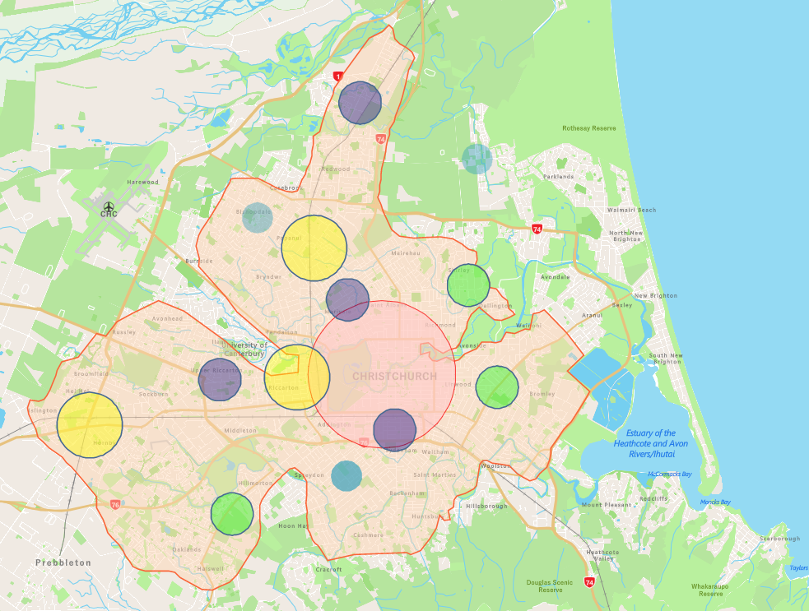
Alternative proposal
Council investigating possibility of new QM restricting extent of MDRS
Focus is on accessibility to core public transport routes and high employment centres
Indicates that about a third of currently included residential zones would be restricted
All high density areas are retained around centres
All existing medium density areas are retained

Slide 19
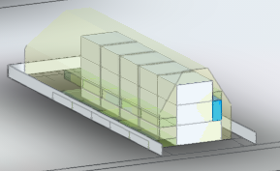
Alternative proposal – Potential Sunlight Access Qualifying Matter
Christchurch is at a different latitude to North Island – sunlight hours differ
Potential for this to be seen as a unique characteristic of the city
Qualifying Matter could be developed to apply to all residential sites
Would seek to reduce recession plane angle from MDRS:
4m at 60°
Reduced height & reduced angle, to be assessed
Act directs that immediate legal effect of MDRS does not apply within a qualifying matter area

Slide 20
Council’s Role
Council must still notify plan change
Not subject to approval of Investigator or Minister – Council must still approve
Under s25 of Act, Minister can appoint person to notify a proposal that the Minister supports

Slide 21
Next steps
February:
Seek approval to notify alternative proposal
Council to continue to engage with the investigator
January:
Brief Council on proposal
Continue to draft evidence
Council to continue to engage with the investigator
December:
Brief Council on proposal
Continue to draft evidence
Council to engage with the investigator
March:
Subject to approval – Notification of Plan Change 14
Notes:
February – we may hold an additional information session prior to the request to notify to ensure the public is informed about what to expect.

Slide 22
The process going forward
Council decision on notification
Date February 2023
Notification – with MDRS immediate legal effect
Mid-late March 2023
Submissions invited
Likely 4-6 weeks (March to May)
Summary of submissions provided
Public provides further written submissions
All provisions come into effect (=non-MDRS density + QM areas)
Likely early 2024
Independent Hearings Panel (IHP) convenes Hearings
Likely over two month period
Council agrees to recommendations
Independent Hearings Panel (IHP) recommends any changes to the Council
Minister for the Environment makes a determination on rejected recommendations
OR
Council does not agree to recommendations
Provisions are shelved
Notes:
Simplified process chart – dates TBC
Confirm the aspects of the NPS-UD / RM Amendment Act that will take effect at notification: MDRS; heritage provisions; qualifying matters.
Note to written submissions vs the timeline for provisions coming into legal effect: There is no bar against people making submissions against the MDRS rules, but the submission will be pointless because the Act requires the Council to include the MDRS in every residential zone (s77G(1)). The IHP does not have the option of leaving them out. The IHP will be able to consider submissions that the District Plan should be more lenient than the MDRS.

Slide 23
Questions

Slide 24
Introducing Mr John Hardie
Crown-appointed Investigator

Slide 25
TOR – Scope of Investigation
12. The investigation will be focused on identifying and understanding the issues, the Council’s perspectives in relation to housing intensification in Christchurch, and the notification of an IPI. Noting the previous Council’s decision on the matter and that a new Council has been elected, the investigation will consider the following: the process for the Council to make decisions on notifying an IPI
the views, issues and concerns the Council has about the draft IPI and the changes proposed to the operative Christchurch District Plan
the perspective of Ngāi Tahu as Treaty partner and mana whenua
the views of any stakeholders if relevant.
13. If potential next steps to make progress emerge, these will be deemed in scope.

Slide 26
TOR – Methodology
14. The investigator will:
in the first five days of the investigation, work with the Council, MfE and MHUD to confirm a project plan
hold interviews/workshops with staff and councillors about the draft IPI
seek the views of Ngāi Tahu as Treaty partner and mana whenua
seek to understand any barriers to notification of an IPI
complete a draft independent report, including recommendations for the Minister on the options for addressing any issues identified in the investigation
finalise and present the report to the Minister.

Slide 27
Thanks for joining us for this webinar
To give feedback about the webinar or ask further questions - engagement@ccc.govt.nz
To talk to the Plan Change team - 03 941 8999

