Slide 1
Kia ora welcome to our webinar
Thanks for joining us. Your camera and mic are turned off, but once the session starts you can interact with the team
Microsoft Teams users:
We recommend you use Slido:
Web browsers (no app):
Go to Slido.com and enter in the code: 894528
Alternatively, you can join using this QR code with your mobile
Ask questions through Q&A tab
React to comments by pressing the ‘thumbs up’
To turn on live captions press the ‘more’ tab and select ‘turn on live captions’
Ask questions during the webinar by emailing: engagement@ccc.govt.nz
When you ask a question, it will be answered by a moderator. You will either get a written answer or an indication that something will be verbally answered so keep Slido open

Slide 2
NPS-UD and Commercial Changes – the detail
Housing and Business Choice – Plan Change 14

Slide 3
What we’re going to cover
Introductions and webinar format
How to participate
Overview of legislative changes
Scope of plan change
Proposed zoning
Commercial and urban design controls
Making feedback & decision making
Wrap up

Slide 4
Introductions and webinar format
Your presenters this evening
Emily Allan – Senior Policy Planner
David Hattam – Senior Urban Designer
Format for the session
Thanks for your questions – will be answered in the presentation
Mics and videos are off to keep the session flowing
We’ll pause for questions throughout the presentation
Mop-up questions at the end

Slide 5
How to participate
Q&A
Teams app – can ask questions on Q&A tab
Not on app – email questions to engagement@ccc.govt.nz
Questions moderated
Answers posted in chat
Slido
Go to Slido.com and enter in the code: 894528
Alternatively, you can join using this QR code with your mobile
Reactions
Thumbs up to show support
In the chat (for questions and answers)
In the tab at the top (for speakers)
Live captions
Turn on in the … (‘more’) tab

Slide 6
Overview of plan change and legislation

Slide 7
We need to make changes to our District Plan
Our population is growing and changing – we need more homes and more variety.
Need to plan for growth to protect productive land, environment and our lifestyle, while providing affordable housing.
Government’s National Policy Statement on Urban Development (NPS-UD) and the Resource Management (Enabling Housing Supply and Other Matters) Amendment Act allows more development.
Opportunity to shape how and where our city grows. What we get to decide for Ōtautahi-Christchurch:
How much higher do we want to go?
Where do we want to concentrate growth?

Slide 8
Scope of influence, control, acceptance
Influence
Accept
Control
We need to accept:
Intensification provisions (incl. MDRS); timelines for notification; technical information and evidence thresholds; Streamlined Process
We can influence:
The extent of some changes (e.g. building heights above new baselines, or the perimeter of the area) – taking the technical evidence into account
We can control:
Our messaging to the community: Planning ahead is way smarter
Notes:
The Control – Influence – Accept model is borrowed from personal development / mental health literature. It’s a useful way of prioritising where energy/effort is expended, and we’re borrowing it to focus our energy and efforts (and yours) on the Plan Changes.
We propose not to spend time today on the matters we need to ‘accept’. We can ‘control’ our comms around them – but these matters are what they are.
We want to engage you on what you – and your communities – can influence.

Slide 9
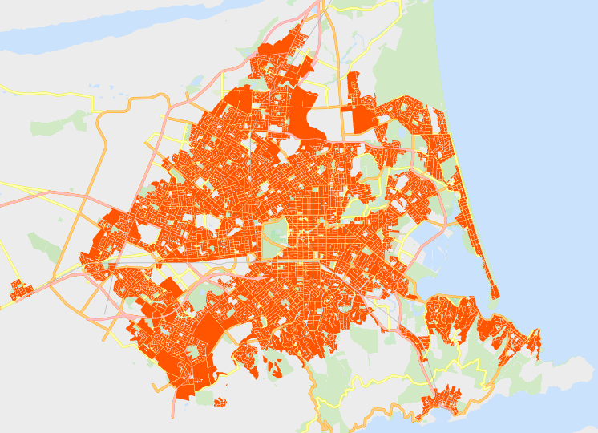
Summary of overall scope
Areas within scope:
All urban residential zones, incl. associated Qualifying Matters
Commercial centres & surrounds
Other associated controls (subdivision, fencing, engineering, access, etc)
Areas outside of scope:
Anything outside of urban environment
New greenfield areas, incl. rural zones
Non-residential activities

Slide 10
Suburban Centres Approach
Intensification directed within and surrounding suburban centres
Degree must respond to scale of commercial activity and community services provided for
Centres hierarchy required to be evaluated, with National Planning Standards alignment
Centre Type | Location | Extent | Enabled Height
Neighbourhood Centre & Local Centre | Addington; Fendalton; Edgeware; Parklands; Woolston; St Martins, etc. | Centre only | MDRS – 12m
‘Large’ Local Centre | Bishopdale; Barrington; Prestons - only | 200m | 14m – four storeys
‘Significant’ Local Centre | Merivale & Sydenham - only | 400m | 20m – six storeys
Town Centre | Church Corner; Linwood; North Halswell, etc. | 400m | 20m – six storeys
‘Emerging’ Metropolitan Centre | Riccarton; Hornby; Papanui - only | 600m | 20m – six storeys
Notes:
NPS-UD direction – what it sets out to achieve
Requirements of us as a Tier 1 council (re MDRS) - what we have to do to meet the Medium Density Residential Standards
Timeline – refer Intensification Streamlined Planning Process – the timeline for giving effect to the NPS-UD has been brought forward by a year
Facts / assumptions underpinning housing sufficiency (what the demand/supply facts tell us)
What can be considered as qualifying matters?
What’s in and out of these plan changes – the givens and what can’t be changed
‘Well functioning urban environment’ – what it means and how we give effect to it
Importance of meeting high evidential thresholds to support proposed changes
What and how does it affect Christchurch (c.f. current District Plan)
Permitted level? (Query whiteboard notes: is this about how high can we go?
Relevant residential zones? (Query whiteboard notes: is this about what happens to these zones now?) How much info do we have on this? This might take more than 10 mins on its own?
E.g. 3 storeys becomes the permitted level (with no resource consent needed). Any application for 4+ storeys will need a RC, but the impact is only assessed as the difference between 3 and 4 storeys, rather than the impact of a 4 storey bldg.

Slide 11
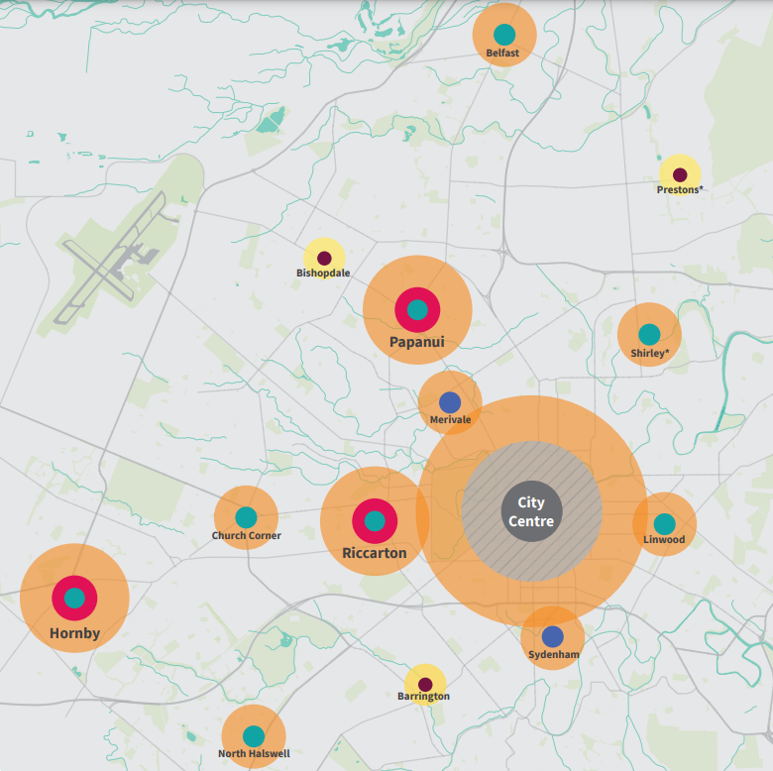
Centres hierarchy – our challenge
A full centres review in the time we have available will need to rely on the positions established through the current District Plan, and any updated information available.
The Greater Christchurch Spatial Plan (under development) may build in metropolitan centres for the future (30yrs + horizon) anyway.
City Centre
Metropolitan Centre
Town Centre
Local Centre
Neighbourhood Centre
Notes:
NPS-UD direction – what it sets out to achieve
Requirements of us as a Tier 1 council (re MDRS) - what we have to do to meet the Medium Density Residential Standards
Timeline – refer Intensification Streamlined Planning Process – the timeline for giving effect to the NPS-UD has been brought forward by a year
Facts / assumptions underpinning housing sufficiency (what the demand/supply facts tell us)
What can be considered as qualifying matters?
What’s in and out of these plan changes – the givens and what can’t be changed
‘Well functioning urban environment’ – what it means and how we give effect to it
Importance of meeting high evidential thresholds to support proposed changes
What and how does it affect Christchurch (c.f. current District Plan)
Permitted level? (Query whiteboard notes: is this about how high can we go?
Relevant residential zones? (Query whiteboard notes: is this about what happens to these zones now?) How much info do we have on this? This might take more than 10 mins on its own?
E.g. 3 storeys becomes the permitted level (with no resource consent needed). Any application for 4+ storeys will need a RC, but the impact is only assessed as the difference between 3 and 4 storeys, rather than the impact of a 4 storey bldg.

Slide 12
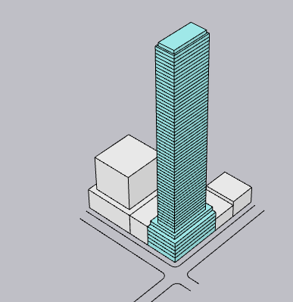
City Centre Zone
Current CCB Zone
Seeking to retain the road wall height threshold at 21m.
Enabling RDA framework seeking to retain the urban design certification process up to 28m.
Enabling RDA framework above 28m, with discretion related to built form and urban design.
Anticipating unlimited heights in the City Centre Zone.

Slide 13
Metropolitan Centres
The NPS-UD defines ‘metropolitan centre zones’ and specifies minimum heights of six storeys in these areas within a walkable catchment.
The National Planning Standards definition is that metropolitan centres have a broad range of:
commercial,
community,
recreational and
residential activities
and is a focal point for sub-regional urban catchments.
We recognise the commercial retail catchments for some of our larger centres, although the definition requires more than just a commercial sub-regional focal point.
We have proposed ‘emerging metropolitan centres’ to recognise these larger commercial centres and to provide a commensurate intensification response for these centres.
These will be zoned Town Centre and the NPS-UD requires a responsive planning framework to respond to changes – meaning they are likely to transition in time.

Slide 14
Commercial Mixed-Use
IG land within walkable catchments of centres is proposed to enable appropriately designed and located residential (like the CCCMU but with greater design controls) by:
Inner city surrounds – rezoning the IG Zone to CMU
In suburban locations - introducing a brownfield overlay.
Similar approach to the central city mixed use zone.
Consent required for most new residential activity (urban design, management of potential reverse sensitivity impacts).
Notes:
CMU – despite its name, doesn’t permitted new commercial activities. In fact commercial activities are limited. The main difference in the zone is that it allows suitably located and designed residential activity (by consent) and most industrial activities (although not those that have the potential to generate significant adverse effects (noise, odour, heavy vehicle movements) on sensitive activities (these should be located in IH Zones).

Slide 15
Questions?
Go to Slido.com and enter in the code: 894528
Alternatively, you can join by scanning this QR code

Slide 16
Proposed Commercial Controls
Zones, standards and urban design

Slide 17
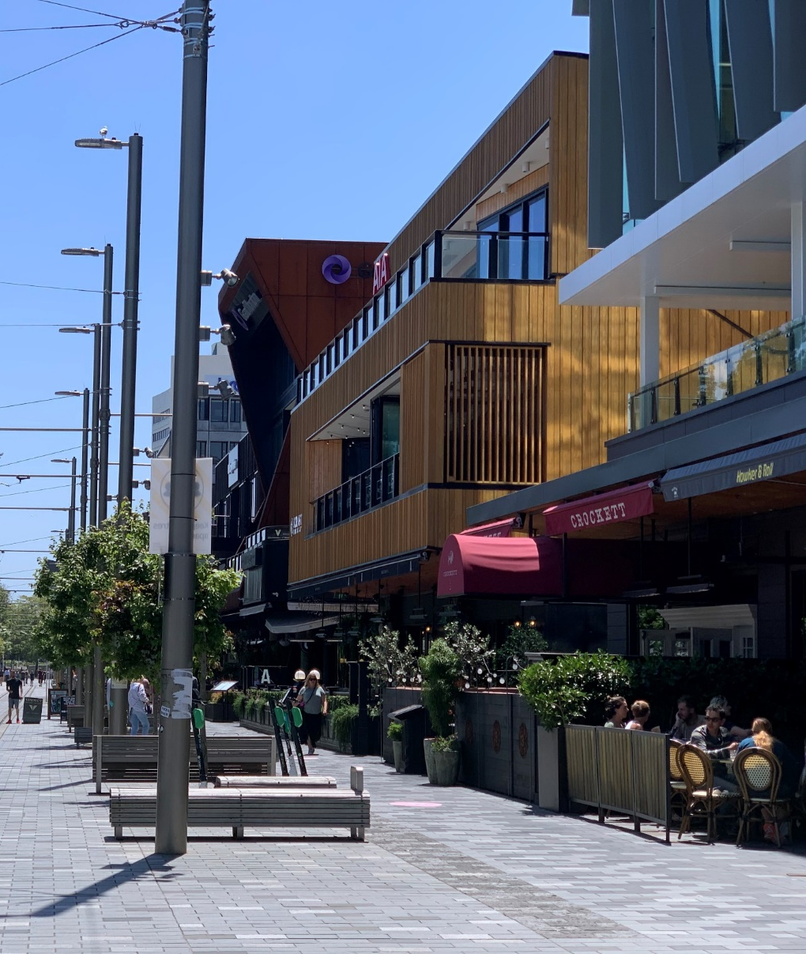
Central City Urban Design Outcomes
Identifiable urban form – city skyline
Contribution to city identity and visual interest
Activation and engagement with public space
Legibility and enclosure of public space
Safe, well connected spaces
Avoidance or mitigation of nuisance effects.
In addition, for residential development:
Provision of communal and private outdoor living space
Sufficient outlook and daylight
Landscape quality
Functional access, circulation and commercial/living space.

Slide 18
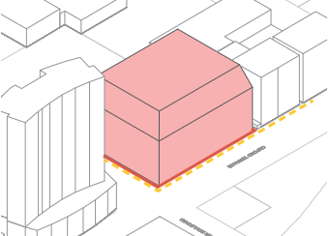
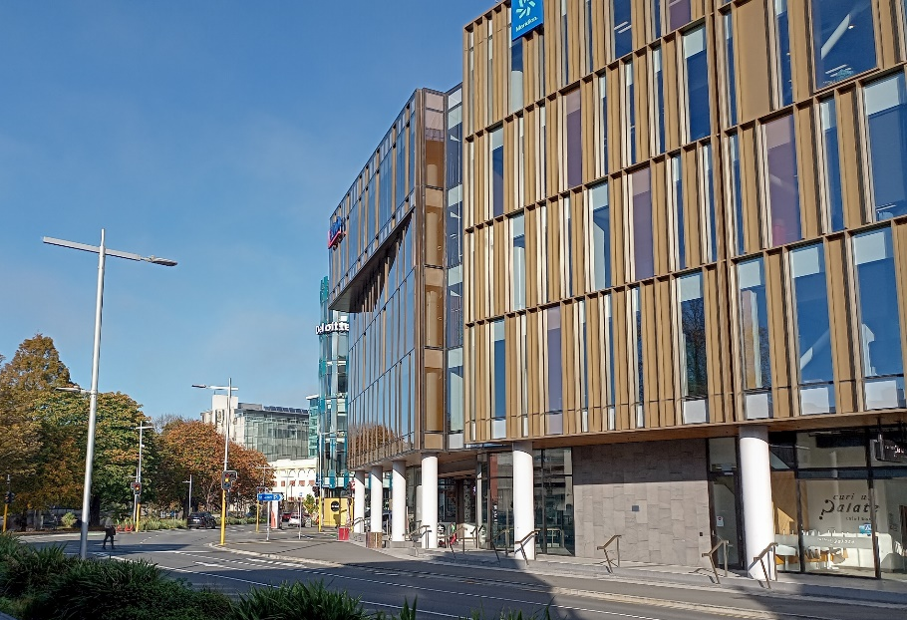
Central City Built Form
The existing Central City Business zone has a height limit of 28m and a road wall of 21m. Equates to about 6 and 8 storeys
Reflects community desire for a low rise city following the earthquakes
Also intended to avoid over-concentration of commercial floor area (i.e. ensure development across the city centre)
Street wall creates a consistent street frame and reduces shading of street.
Existing development envelope

Slide 19
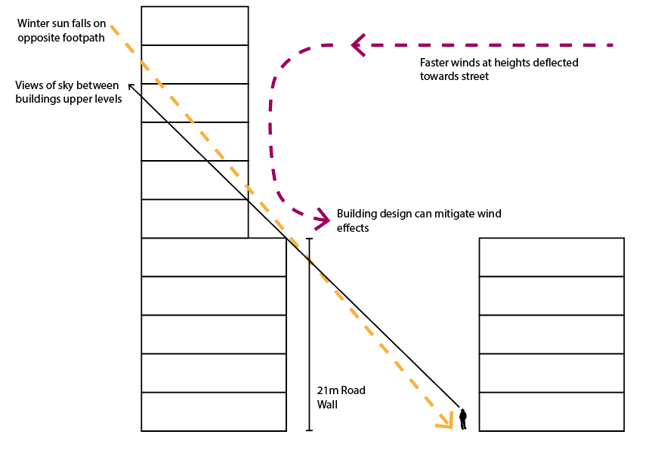
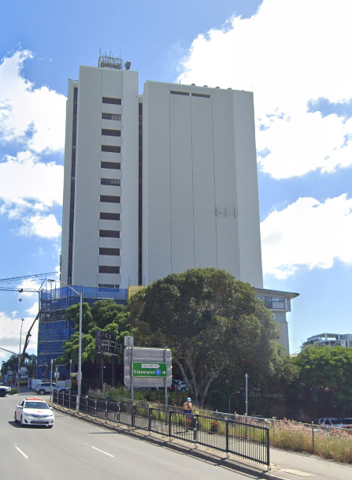
Central City
Some potential issues with taller buildings:
Shading of public space
Outlook from buildings
Visual dominance
Prominent blank walls
Wind
High visibility increases visual impacts (compared to lower buildings).

Slide 20
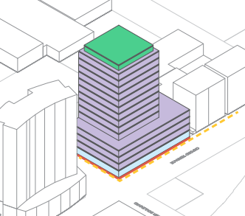
Central City
Building Envelope
Proposed rules keep existing envelope for the first 28m.
Allow additional development above, with the following rules to manage its impact:
6m setback from any boundary
40m max dimension
50% site coverage (tower only)
1m roof setback.
Above – possible new building form

Slide 21
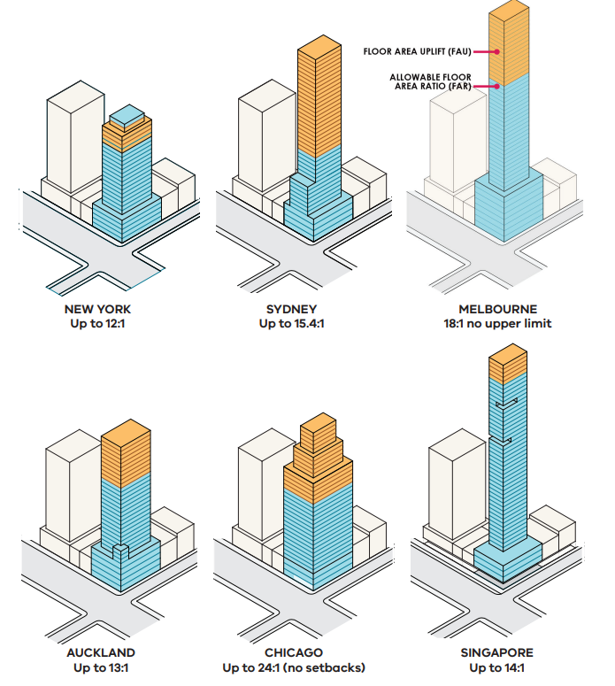
Central City Comparison
Floor Area Ratio:
A measure of the amount of development on the site.
1:1 means 1m² of GFA for every m² of site area
Central City Built Form Review (Melbourne, Hodyl+Co, 2016)

Slide 22
Central City Comparison
Proposed Christchurch: 26:1 or more
Central City Built Form Review (Melbourne, Hodyl+Co, 2016)

Slide 23
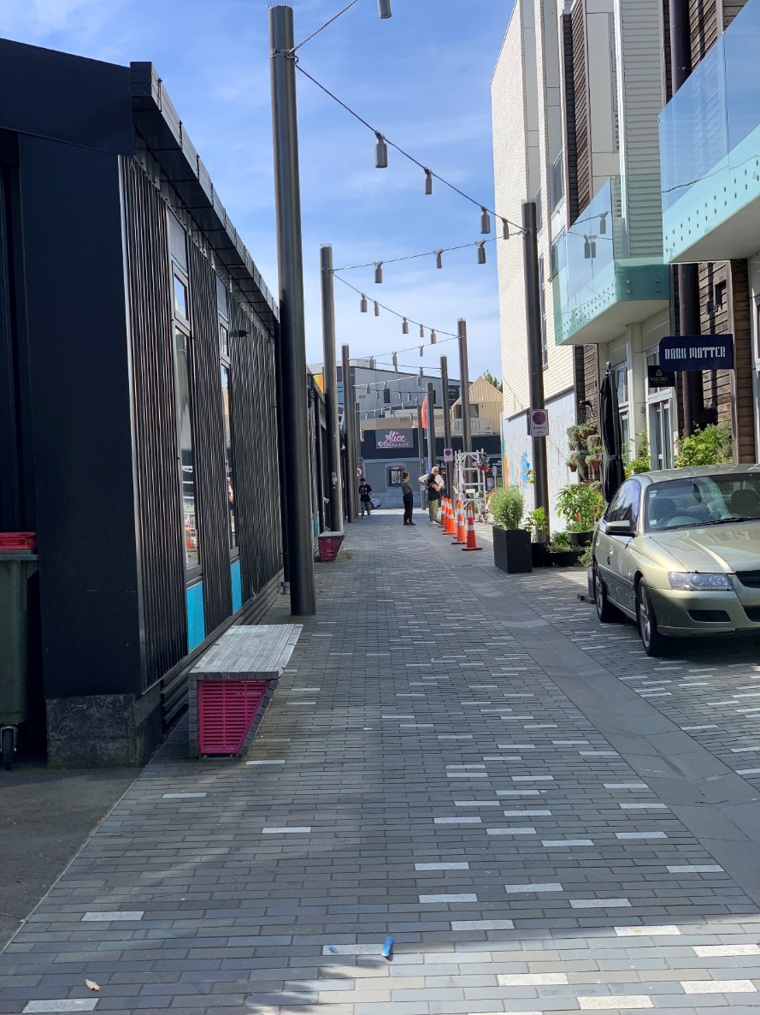
Mixed Use Zones
Industrial areas transitioning to a mix of uses including residential
Controls vary depending upon location
Includes:
South Frame
Land around the fringes of the central city
Land in areas such as Sydenham

Slide 24
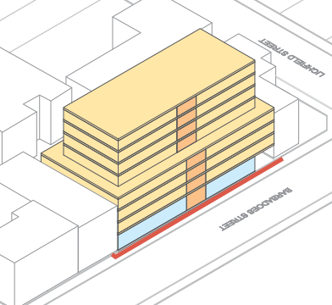
Mixed Use Zones
Proposed to cover a larger area (e.g. extended to Sydenham)
Includes MDRS style controls (but more permissive than Residential zones i.e. building envelope)
Generally around the city centre zone. 32m (approx. 10 storey) height limit, but built form standards apply over 17m:
4m setback from any boundary
40m max dimension
50% site coverage (above 17m)
Now incorporates reference to residential design principles and landscaping provisions.

Slide 25
Other commercial centre zones
Few changes are proposed to these zones, because current planning provisions largely reflect expected heights and densities:
Taller buildings are permitted in District Centres already (although not often built)
Height limits in local and neighbourhood centres are proposed to be 12m-14m (3 and 4 storeys)
Proposed MDRS style built form controls.

Slide 26
Questions?
Go to Slido.com and enter in the code: 894528
Alternatively, you can join by scanning this QR code

Slide 27
Have your Say
Provide feedback until 13 May

Slide 28
What can you provide feedback on?
Name | Description
Draft Housing and Business Choice (Plan Change 14) | Shaping how and where we grow by enabling more development within the city’s existing footprint. We need to make these changes to give effect to the Government’s National Policy Statement- Urban Development (NPS-UD) and recent amendments to the Resource Management Act (RMA) that enable greater housing supply.
Draft Coastal Hazards (Plan Change 12) | Avoiding increased harm to people an property exposed to coastal hazards such as flooding and erosion.
Draft Heritage (Plan Change 13) | Creating new residential heritage areas to protect Christchurch’s special identity and character – we are proposing that 11 new residential heritage areas across the city be identified in the District Plan to protect Christchurch’s special identity and heritage values. Adding a total of 65 buildings, items and interiors to the Schedule of Significant Historic Heritage.
Draft Radio Communication Pathways (Plan Change 15) | Protecting our emergency radio communication airspace by controlling building heights/development that block it.
Notes:
We have talked about the various plan changes in passing. This table lays out the different jigsaw pieces and where each one fits in.
Note that a more detailed A3 Table is to be circulated to EMs on the different plan changes, and the different components of them (inform approach v influence approach).
Note that the Christchurch Transport Plan and Flood Management Areas work is progressing in parallel, but decisions to consult on and/or notify these pieces of work will be sought later. (7 April for the CTP, and post notification for the FMA)
This work is also being carried out in the context of the development of the Greater Christchurch Spatial Plan (GCSP), and the Otautahi Christchurch Plan (OCP)

Slide 29
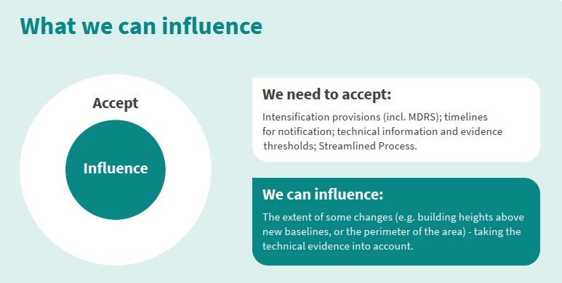
What can you provide feedback on?
Do you have any comments about other elements of the proposed Draft Heritage Plan Change?
Do you have any comments on the proposed Residential Heritage Areas?
ccc.govt.nz/haveyoursay

Slide 30
Questions?
Go to Slido.com and enter in the code: 894528
Alternatively, you can join by scanning this QR code

Slide 31
Thanks for joining us for this webinar
To give feedback about the webinar: engagement@ccc.govt.nz
To discuss any of the issues with the team: planchange@ccc.govt.nz
Phone: 03 941 6886
Other webinars you may wish to attend
Commercial Intensification - Tuesday 3 May, 6.30pm–8pm

