Slide 1
Kia ora - welcome to our webinar
Thanks for joining us. Your camera and mic are turned off, but once the session starts you can interact with the team
Microsoft Teams app users
Ask questions through Q&A tab.
React to comments by pressing the “thumbs up”.
To turn on live captions press the … ‘more’ tab and select ‘turn on live captions’
Web browsers (no app)
You do not have access to Q&A.
Ask questions during the webinar by emailing: engagement@ccc.govt.nz
Mobile users
View in landscape to see the whole webinar.
Q&A uses the whole screen so you can’t view slides while asking questions.
Q&A on mobile is laggy. You may have to leave and re-join the webinar to gain access to this feature.

Slide 2
Housing Choices Plan Change
Infrastructure, including vacuum sewers

Slide 3
What we are going to cover
Introductions and webinar format
How to participate
Proposed changes to our District Plan
A brief history of vacuum sewers
Vacuum sewers and increased development
What this means for property owners

Slide 4
Introductions and webinar format
Your presenters this evening
Ike Kleynbos - Senior Policy Planner
Michele McDonald - Team Leader Asset Planning
Format for the session
Thanks for your questions – will be answered in the presentation
Mics and videos are off to keep the session flowing
We’ll pause for questions throughout the presentation
Mop-up questions at the end

Slide 5
How to participate
Q&A
Teams app - can ask questions on Q&A tab
Questions moderated
Answers posted in chat
Reactions
Thumbs up to show support
In the chat (for questions and answers)
In the tab at the top (for speakers)
Live captions
Turn on in the … (‘more’) tab

Slide 6
We need to make changes to our District Plan
Population is growing and changing.
Need to plan for growth to protect productive land, environment and our lifestyle, while providing affordable housing.
Government’s National Policy Statement on Urban Development and the Resource Management (Enabling Housing Supply and Other Matters) Amendment Act allows more development.
Opportunity to shape how and where our city grows. What we get to decide for Ōtautahi-Christchurch:
How much higher do we want to go?
Where do we want to concentrate growth ?

Slide 7
What the new legislation means
Up to three storeys (12 metres) across most of the city, and up to three houses per section, without requiring a consent – known as MDRS (Medium Density Residential standards).
MDRS must apply to all ‘relevant’ residential zones within the ‘urban environment’ – both set.
We have to allow more housing to be built.
Situations when developments require neighbour approval and rules for subdivisions needs to change – we have to allow more development.
We can identify Qualifying matters in areas that are unsuitable for increased housing– they aren’t a way to stop all intensification.

Slide 8
Proposed Qualifying Matters
Strong evidence required to become a Qualifying Matter
Doesn’t provide blanket protection from more housing.
generally be confined to specific location
alternative levels of intensification are proposed
Character areas
Significant trees
Residential Heritage Areas
Coastal hazards areas
400v power line setbacks
Lyttelton Port’s Hillsborough City Depot surrounds
Radio Communication Pathways for the Justice and Emergency Services Precinct
Vacuum sewer wastewater system constraint areas

Slide 9
Qualifying Matters – Existing Infrastructure Constraints
Propose Shirley, Aranui and Prestons exempt from increased housing density.
Vacuum sewer pipes in Shirley and Aranui have reached capacity
can only accept like-for-like development
Prestons development must align with Prestons Sewer Master Plan.
Proposal to require potential developers to check water and sewer network capacity prior to planning new development.
Combined Community Boards’ briefing, 7 April 2022

Slide 10
Questions?
Do you have any questions about the government legislation?
Council cannot change the legislation but we can help you understand it
Do you have any questions about qualifying matters?
We can have some influence over these but the rules are pretty tight

Slide 11
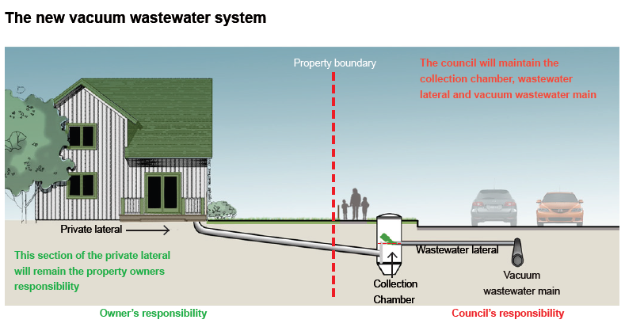
A brief history of vacuum sewers
Vacuum sewers installed post-quake
Pressure sewer systems were not selected for these areas because:
Works on private property - owner consent
Owner agreement on location of pump
Social impacts
Aesthetic issues
Construction on private property
Agreement needed / vesting of infrastructure
Works on private property susceptible to abuse / misuse
Ongoing maintenance accessibility issues
Flotation of tanks in liquefied ground
Higher initial capital costs / higher life cycle cost
Houses connected to vacuum valve/collection chamber
Vacuum pump station creates vacuum in pipes
Valves open pneumatically, wastewater is sucked out of chamber towards vacuum pump station.

Slide 12
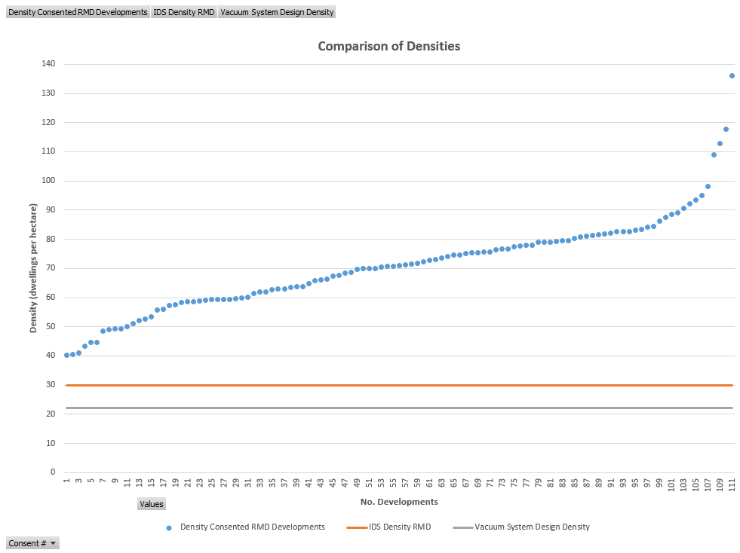
Vacuum sewers and increased development
Pipes were sized for properties subdivided to 450 m² + provision for a driveway
Vacuum pits designed and placed for current number of dwellings only
Cannot accommodate MDRS levels of development
dwellings per hectare
Medium Density Residential developments
Minimum Residential Medium Density (current District Plan)
Vacuum sewer design density
Aranui design 11 - 29 houses per hectare
Shirley design at 10 - 16 houses per hectare
Subdivision consents processed

Slide 13
What would an upgrade look like?
Bigger pipes or more pipes, where they’ve reached maximum flow capacity
Upgraded pump station, vacuum pumps, vacuum collection tank, wastewater pumps and rising main, or satellite pump stations
More vacuum sewer valve chambers. Redesign may also be needed - adding more chambers only alters air-to-liquid ratio
Vacuum sewers

Slide 14
What this means for local property owners
Aranui and Shirley
Can accept like for like development only at present
Property owners will be asked to inspect and if found faulty, repair their private laterals
Additional development won’t be possible until the system has been upgraded or up to 50% I&I reduction have been achieved
Prestons
Development that aligns with the vacuum sewer master plan
Property owners may be asked to inspect and if found faulty, repair their private laterals

Slide 15
Questions?
Do you have any questions about vacuum sewers?

Slide 16
Have your Say
Provide feedback until 13 May
ccc.govt.nz/haveyoursay

Slide 17
What can you provide feedback on?
Name | Description
Draft Housing and Business Choice (Plan Change 14) | Shaping how and where we grow by enabling more development within the city’s existing footprint. We need to make these changes to give effect to the Government’s National Policy Statement- Urban Development (NPS-UD) and recent amendments to the Resource Management Act (RMA) that enable greater housing supply.
Draft Coastal Hazards (Plan Change 12) | Avoiding increased harm to people an property exposed to coastal hazards such as flooding and erosion.
Draft Heritage (Plan Change 13) | Creating new residential heritage areas to protect Christchurch’s special identity and character – we are proposing that 11 new residential heritage areas across the city be identified in the District Plan to protect Christchurch’s special identity and character and adding a total of 65 buildings, items and interiors to the Schedule of Significant Historic Heritage.
Draft Radio Communications Pathways (Plan Change 15) | Protecting our emergency radio communication airspace by controlling building heights/development that block it.
Notes:
We have talked about the various plan changes in passing. This table lays out the different jigsaw pieces and where each one fits in.
Note that a more detailed A3 Table is to be circulated to EMs on the different plan changes, and the different components of them (inform approach v influence approach).
Note that the Christchurch Transport Plan and Flood Management Areas work is progressing in parallel, but decisions to consult on and/or notify these pieces of work will be sought later. (7 April for the CTP, and post notification for the FMA)
This work is also being carried out in the context of the development of the Greater Christchurch Spatial Plan (GCSP), and the Otautahi Christchurch Plan (OCP)

Slide 18
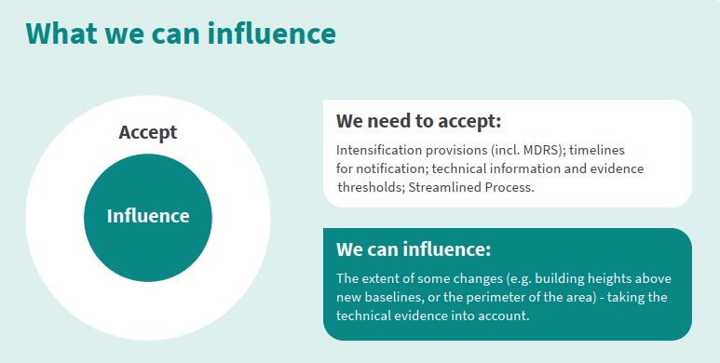
What can you provide feedback on?
Do you have comments about the proposed Qualifying Matters, including vacuum sewer systems?
Does the proposed plan change allow for enough business intensification?
Are we proposing to allow development above three storeys in the right places?
Are we enabling development to go high enough, in the right places?
Have we gone far enough out from our commercial centres?
Are our boundaries for the different zones in the right places?
Have we got the thresholds right for requiring a resource consent?
ccc.govt.nz/haveyoursay

Slide 19
Decision making process
This is your opportunity to share feedback now during the pre-notification period.
Precedes formal notification of Plan Changes by 20 August 2022
All controls relating to MDRS will have immediate legal effect once the Council notifies the plan change.

Slide 20
Questions?
Final mop-up

Slide 21
Thanks for joining us for this webinar
To give feedback about the webinar
Email: engagement@ccc.govt.nz
To discuss any of the issues with the team
email: planchange@ccc.gov.nz
Phone: 03 941 6886
Other webinars you may wish to attend
Heritage & Character areas - Wednesday 27 April, 6.30pm–8pm
Coastal Hazards - Thursday 28 April, 6.30pm–8pm
Residential intensification - Monday 2 May, 6.30pm–8pm
Commercial intensification - Tuesday 3 May, 6.30pm–8pm

